Slide 1


Data Analysis for the Life Sciences Chapter 4: Linear Models
Sections 4.1 to 4.2

Slide 2
Linear Models: Introduction
This Book:
Focus on linear models that represent dichotomous groups: treatment versus control
Then, move to more complex models, but continue to focus on dichotomous [explanatory] variables

Slide 3
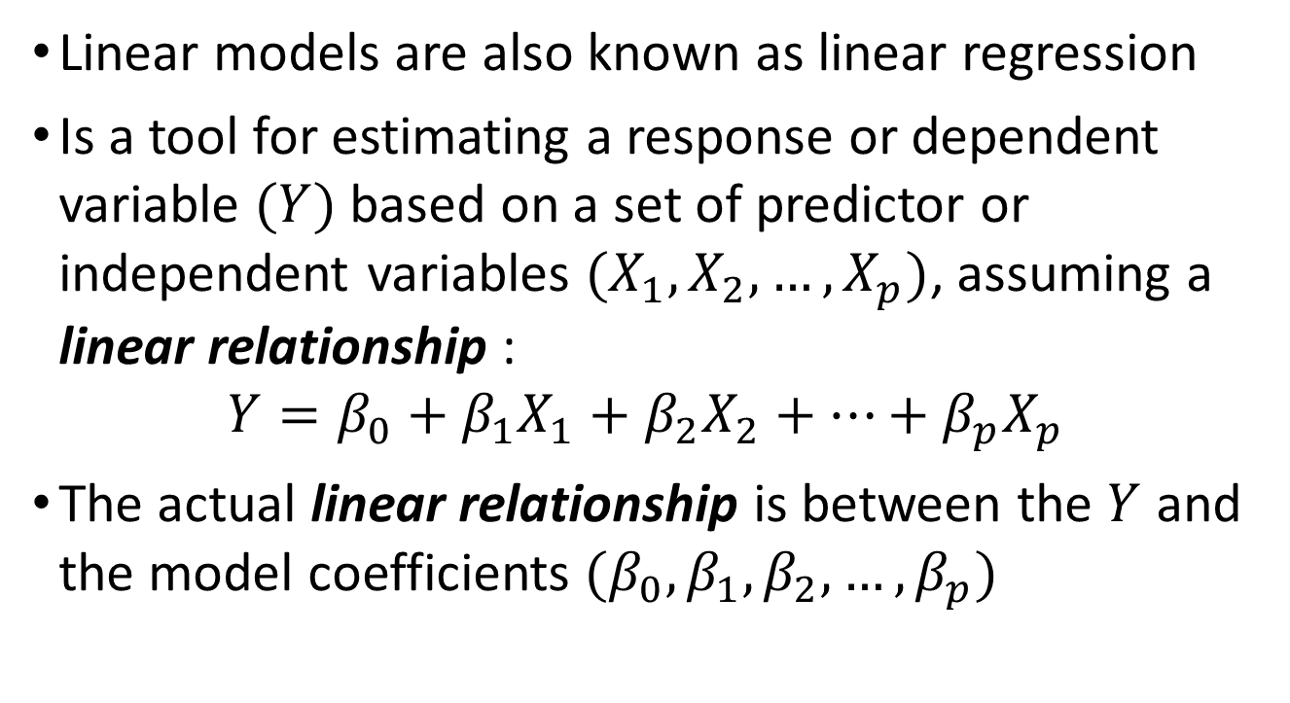
Linear Models: Introduction
Linear models are also known as linear regression
Is a tool for estimating a response or dependent variable $(Y)$ based on a set of predictor or independent variables $(X_{1},X_{2},…,X_{p})$, assuming a linear relationship :
$$Y=β_{0}+β_{1}X_{1}+β_{2}X_{2}+…+β_{p}X_{p}$$
The actual linear relationship is between the $Y$ and the model coefficients $(β_{0},β_{1},β_{2},…,β_{p})$

Slide 4
Linear Models: Introduction
Why fit Linear Models?
Explanation:
To know (explore?) the relationship between the explanatory variables and the dependent variable
Examples?
Galileo in the 16th century trying to describe the velocity of a falling object
Objective:
minimal number of explanatory variables
Prediction:
To create predictions for new cases.
Examples?
Father & son heights
Objective:
minimal number of explanatory variables

Slide 5
Linear Models: Introduction - Exercises
The standard error of an estimate is the standard deviation of the sampling distribution of an estimate.
Our estimate of the mean of a population changed depending on the sample that we took from the population.
If we repeatedly sampled from the population and each time estimated the mean, the collection of mean estimates would form the sampling distribution of the estimate.
When we took the standard deviation of those estimates, that was the standard error of our mean estimate.

Slide 6
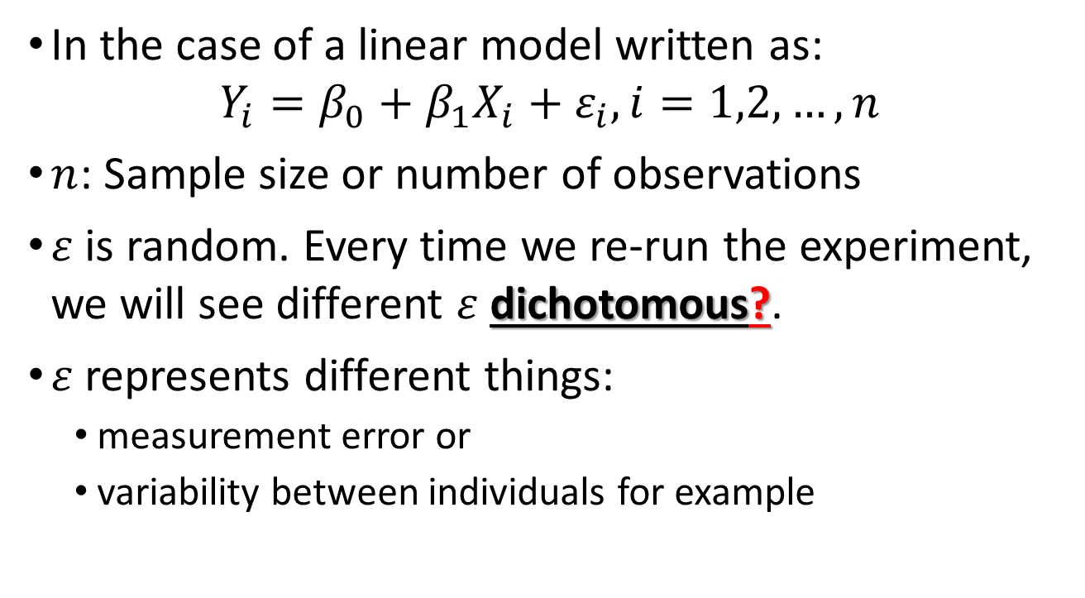
Linear Models: Introduction - Exercises
In the case of a linear model written as:
$$Y_{i}=β_{0}+β_{1}X_{i}+ε_{i}, i=1,2,…,n$$
$n$: Sample size or number of observations
$ε$ is random. Every time we re-run the experiment, we will see different $ε$ dichotomous?.
$ε$represents different things:
measurement error or
variability between individuals for example

Slide 7
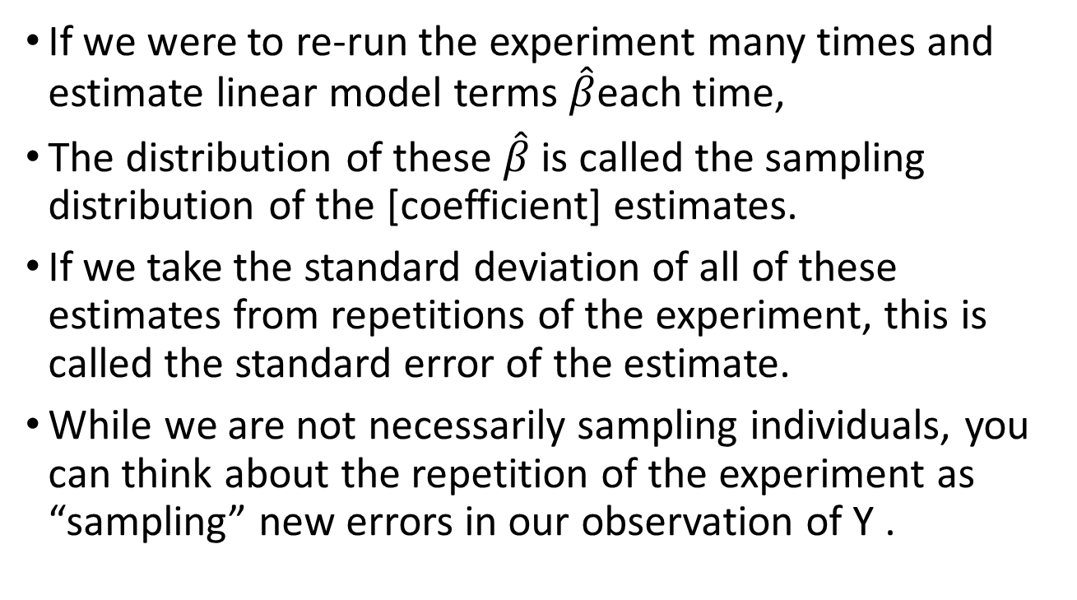
Linear Models: Introduction - Exercises
If we were to re-run the experiment many times and estimate linear model terms $\hat{β}$each time,
The distribution of these $\hat{β}$ is called the sampling distribution of the [coefficient] estimates.
If we take the standard deviation of all of these estimates from repetitions of the experiment, this is called the standard error of the estimate.
While we are not necessarily sampling individuals, you can think about the repetition of the experiment as “sampling” new errors in our observation of Y .

Slide 8
Linear Models: Introduction - Exercises
Galileo's falling object data:
g = 9.8
h0 = 56.67
v0 = 0
n = 25
tt = seq(0,3.4,len=n)
y = h0 + v0 *tt - 0.5* g*tt^2 + rnorm(n,sd=1)

Slide 9
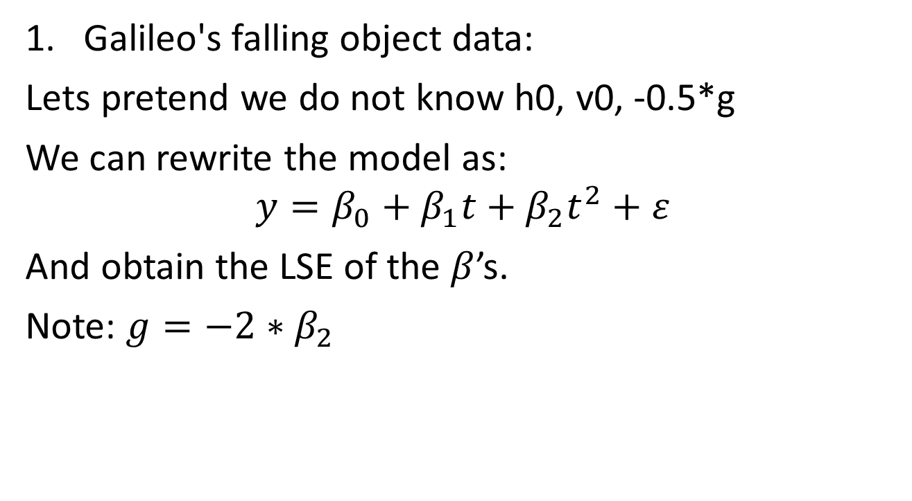
Linear Models: Introduction - Exercises
Galileo's falling object data:
Lets pretend we do not know h0, v0, -0.5*g
We can rewrite the model as:
$$y=β_{0}+β_{1}t+β_{2}t^{2}+ε$$
And obtain the LSE of the $β$’s.
Note: ${g=−2∗β}_{2}$

Slide 10
Linear Models: Introduction - Exercises
To obtain the LSE:
X = cbind(1,tt,tt^2)
A = solve(crossprod(X))%*%t(X)
Given how we have defined A, which of the following is the LSE of g, the acceleration due to gravity? Hint: try the code in R.
A) 9.8
B) A %*% y
C) -2 * (A %*% y) [3]
D) A[3,3]

Slide 11
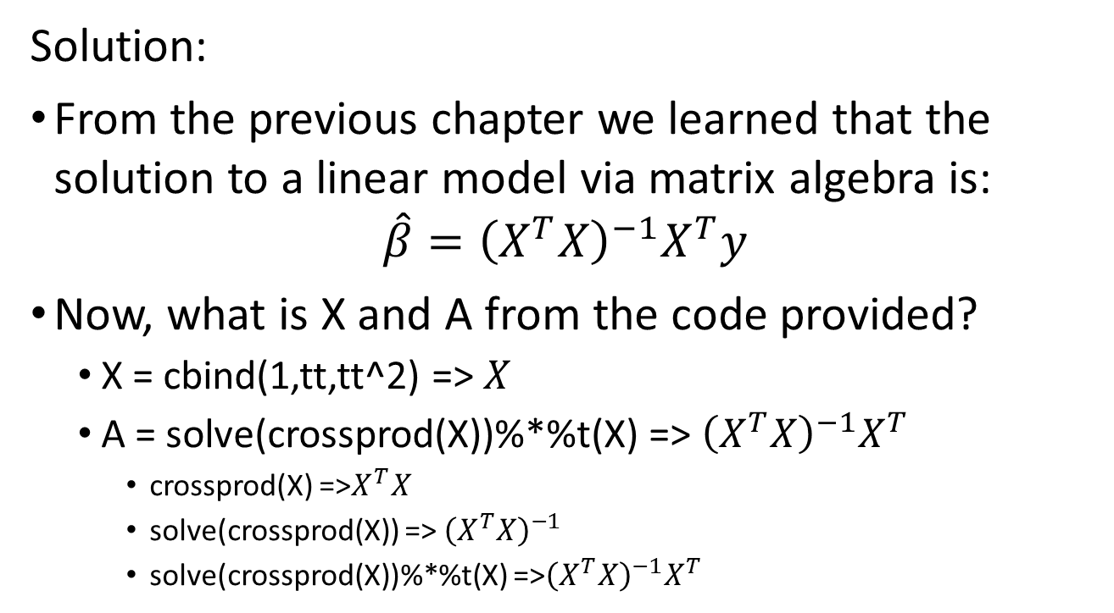
Linear Models: Introduction - Exercises
Solution:
From the previous chapter we learned that the solution to a linear model via matrix algebra is:
$$\hat{β}={\left(X^{T}X\right)}^{−1}X^{T}y$$
Now, what is X and A from the code provided?
X = cbind(1,tt,tt^2) => $X$
A = solve(crossprod(X))%*%t(X) => ${\left(X^{T}X\right)}^{−1}X^{T}$
crossprod(X) =>$X^{T}X$
solve(crossprod(X)) => ${\left(X^{T}X\right)}^{−1}$
solve(crossprod(X))%*%t(X) =>${\left(X^{T}X\right)}^{−1}X^{T}$

Slide 12
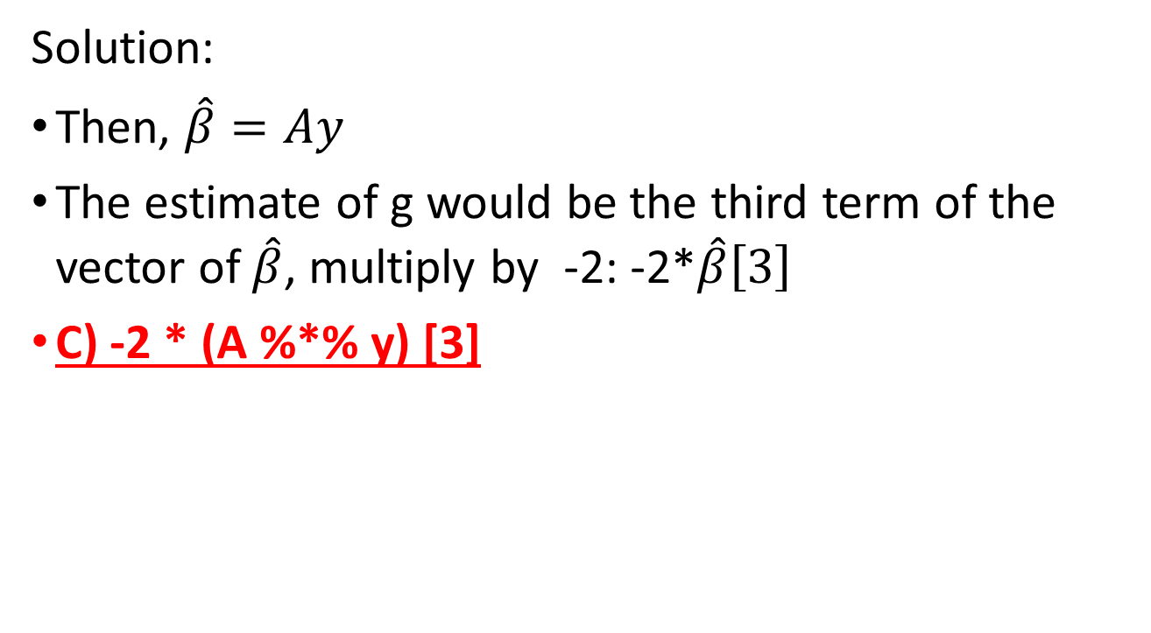
Linear Models: Introduction - Exercises
Solution:
Then, $\hat{β}=Ay$
The estimate of g would be the third term of the vector of $\hat{β}$, multiply by -2: -2*$\hat{β}\left[3\right]$
C) -2 * (A %*% y) [3]

Slide 13
Linear Models: Introduction - Exercises
Solution:
In R:
g = 9.8
h0 = 56.67
v0 = 0
n = 25
tt = seq(0,3.4,len=n)
y = h0 + v0 *tt - 0.5* g*tt^2 + rnorm(n,sd=1)
X = cbind(1,tt,tt^2)
A = solve(crossprod(X))%*%t(X)
beta=A%*%y
ghat=-2*beta[3]

Slide 14
Linear Models: Introduction - Exercises
In the lines of code above, the function rnorm introduced randomness. This means that each time the lines of code above are repeated, the estimate of g will be different.
Use the code above in conjunction with the function replicate to generate 100,000 Monte Carlo simulated datasets. For each dataset, compute an estimate of g. (Remember to multiply by -2.)
What is the standard error of this estimate?

Slide 15
Linear Models: Introduction - Exercises
Solution:
g = 9.8
h0 = 56.67
v0 = 0
n = 25
tt = seq(0,3.4,len=n)
X = cbind(1,tt,tt^2)
A = solve(crossprod(X))%*%t(X)
betahat=replicate(100000,{
y = h0 + v0 *tt - 0.5* g*tt^2 + rnorm(n,sd=1)
betahats <- A%*%y
return(betahats[3])
})
SE=sd(betahat)
print(SE
#[1] 0.2143514

Slide 16
Linear Models: Introduction - Exercises
In the father and son height examples, we have randomness because we have a random sample of father and son pairs. For the sake of illustration, let’s assume that this is the entire population:
library(UsingR)
x = father.son$fheight
y = father.son$sheight
n = length(y)

Slide 17
Linear Models: Introduction - Exercises
Now let’s run a Monte Carlo simulation in which we take a sample of size 50 over and over again. Here is how we obtain one sample:
N = 50
index = sample(n,N)
sampledat = father.son[index,]
x = sampledat$fheight
y = sampledat$sheight
betahat = lm(y~x)$coef
Use the function replicate to take 10,000 samples.
What is the standard error of the slope estimate? That is, calculate the standard deviation of the estimate from the observed values obtained from many random samples

Slide 18
Linear Models: Introduction - Exercises
Solution:
#Monte Carlo simulation:
N = 50
B = 10000
betahat<-replicate(B,{
index = sample(n,N)
sampledat = father.son[index,]
x = sampledat$fheight
y = sampledat$sheight
betahats = lm(y~x)$coef
return(betahats[2])
})
SE=sd(betahat)
print(SE)
# [1] 0.1243796

Slide 19
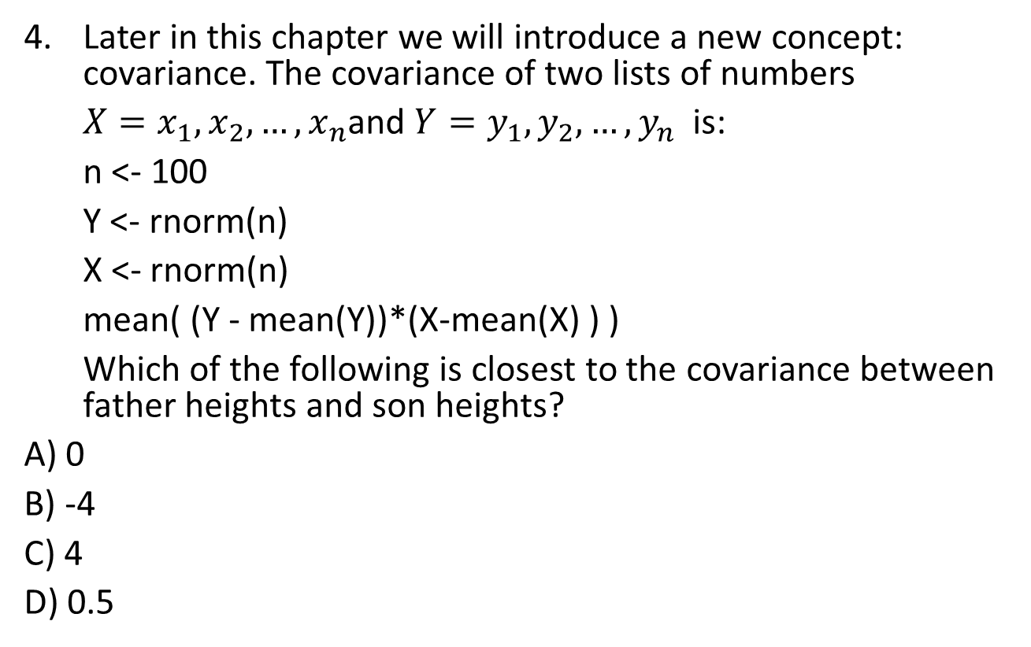
Linear Models: Introduction - Exercises
Later in this chapter we will introduce a new concept: covariance. The covariance of two lists of numbers
$X=x_{1},x_{2},…,x_{n}$and $Y=y_{1},y_{2},…,y_{n}$ is:
n <- 100
Y <- rnorm(n)
X <- rnorm(n)
mean( (Y - mean(Y))*(X-mean(X) ) )
Which of the following is closest to the covariance between father heights and son heights?
A) 0
B) -4
C) 4
D) 0.5

Slide 20
Linear Models: Introduction - Exercises
Solution:
x = father.son$fheight
y = father.son$sheight
mean( (x - mean(x))*(y-mean(y)))
# [1] 3.869739
Answer: C) 4

Slide 21
Design Matrix
Definition (From the Cambridge Dictionary of Statistics):
In statistics, a design matrix is a matrix of values of explanatory variables of a set of objects, often denoted by X. Each row represents an individual object, with the successive columns corresponding to the variables and their specific values for that object. The design matrix is used in certain statistical models, e.g., the general linear model.
Usually used in experimental design, when the aim is to look at the differences between “treatments”.
Similar to ANOVA, where we want to identify the effect of a factor within and between groups.
Also known as the model matrices

Slide 22
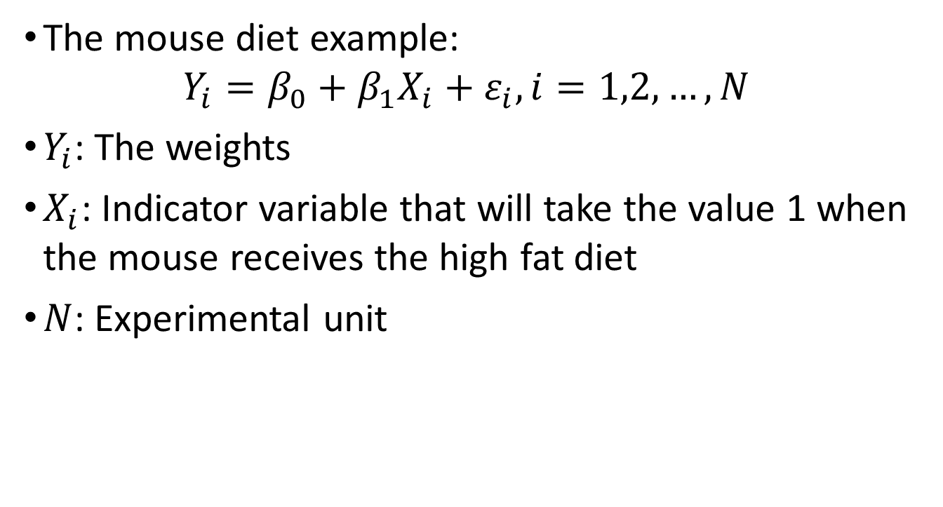
Design Matrix
The mouse diet example:
$$Y_{i}=β_{0}+β_{1}X_{i}+ε_{i}, i=1,2,…,N$$
$Y_{i}$: The weights
$X_{i}$: Indicator variable that will take the value 1 when the mouse receives the high fat diet
$N$: Experimental unit

Slide 23
Design Matrix
Matrix representation:

